Slide 1
Fake Social Media Profile Detection System
01
P ARCHANA (44110556)
02
OVIYA V ARUN (44110555)
03
POOJA S (44110588)
04
PRAKAASHINI J (44110596)
.

Slide 2
CONTENTS
Introduction
Fake profile
Solution Overview
Machine Learning &
Deep Learning
Techniques
Data Collection &
Preprocessing
Expected Outcomes &
Benefits
Code
Output

Slide 3
INTRODUCTION:-
In the modern age, the proliferation of fake social media profiles, bots, and malicious actors has become a significant issue. Detecting fake profiles on social media is crucial to preventing misinformation, fraud, and maintaining platform integrity. A Machine Learning (ML) or Deep Learning (DL) based system can leverage multiple factors such as metadata, activity patterns, and content authenticity to determine the likelihood that a profile is fake

Slide 4

FAKE PROFILE:-
• The rise of fake profiles on social media poses security and trust issues.
• Fake accounts are used for scams, misinformation, and bot-driven activities.
• Need an automated solution to detect and mitigate fake profiles in real-time.
.

Slide 5


Solution Overview:-
• Develop an ML/DL-based system to identify fake profiles
• Analyze metadata (account age, follower ratios)
• Detect activity patterns (post frequency, engagement anomalies)
• Assess content authenticity (image hashes, NLP for text analysis)
• Integrate with a REST API for real-time detection.

Slide 6
Machine Learning & Deep Learning Techniques
• Feature Engineering: Extract metadata and behavioral patterns
• ML Models: Decision Trees, Random Forest, SVM for pattern classification
• DL Models: CNN for image analysis, LSTM for text-based anomaly detection
• Anomaly Detection: Unsupervised learning (Autoencoders, Isolation Forests).

Slide 7
Data Collection & Preprocessing
• Collect social media profile data (real & fake profiles labeled dataset)
• Extract features: Account metadata, posts, follower patterns, images
• Clean & preprocess text using NLP (removing spam patterns, embeddings)
• Convert images to hash signatures for similarity detection.

Slide 8
Expected Outcomes & Benefits:-
• High accuracy in fake profile detection
• Reduced spread of misinformation and scams
• Improved trust in social media platforms
• Real-time detection enabling quick action against fraudulent accounts.

Slide 9
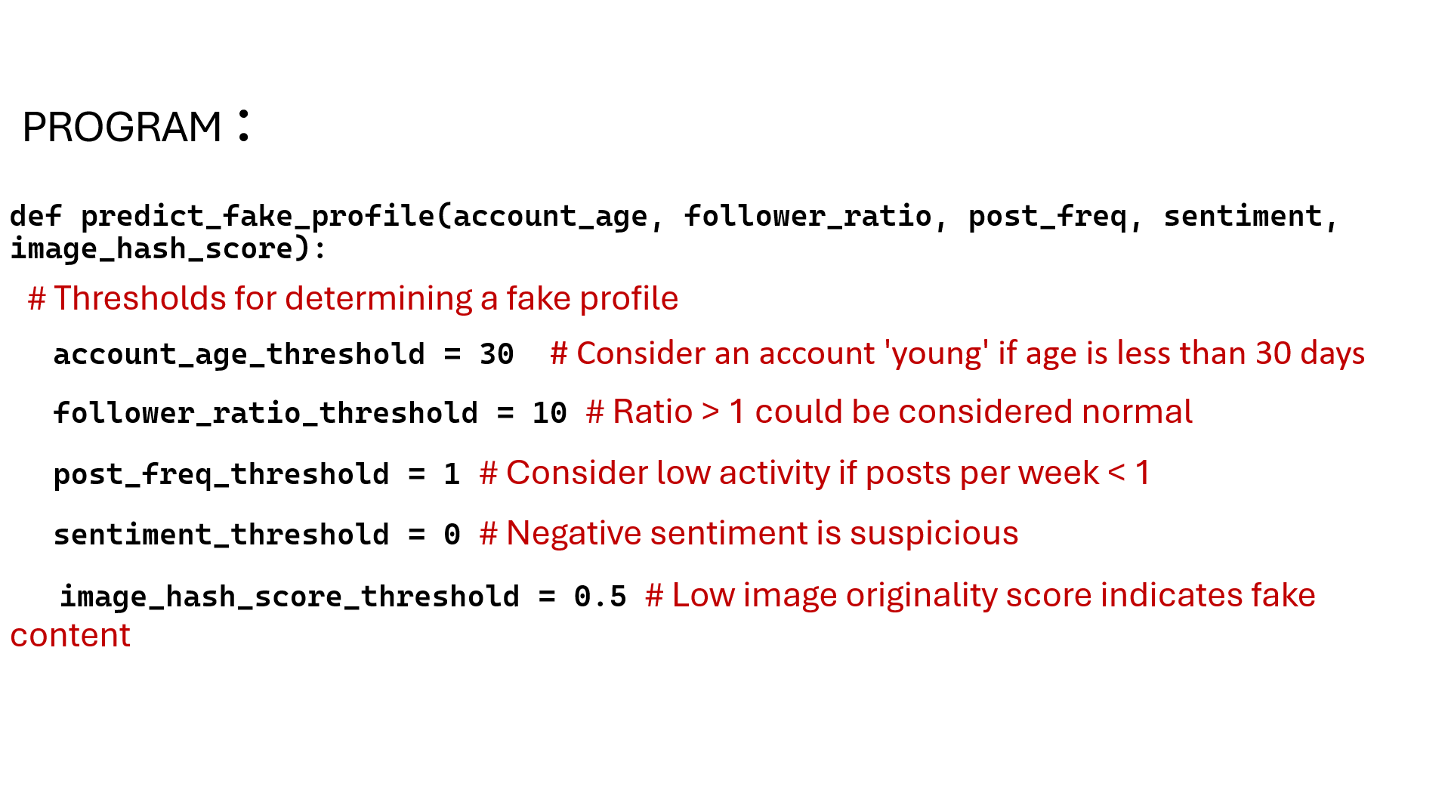

Slide 10
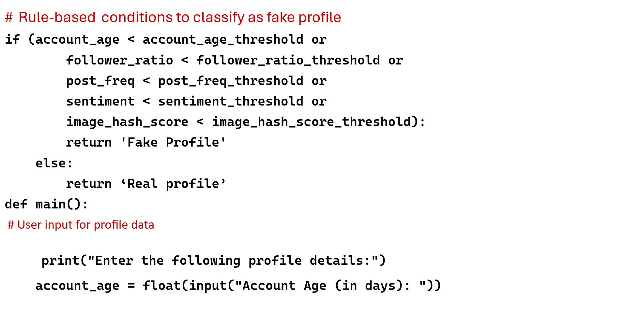

Slide 11
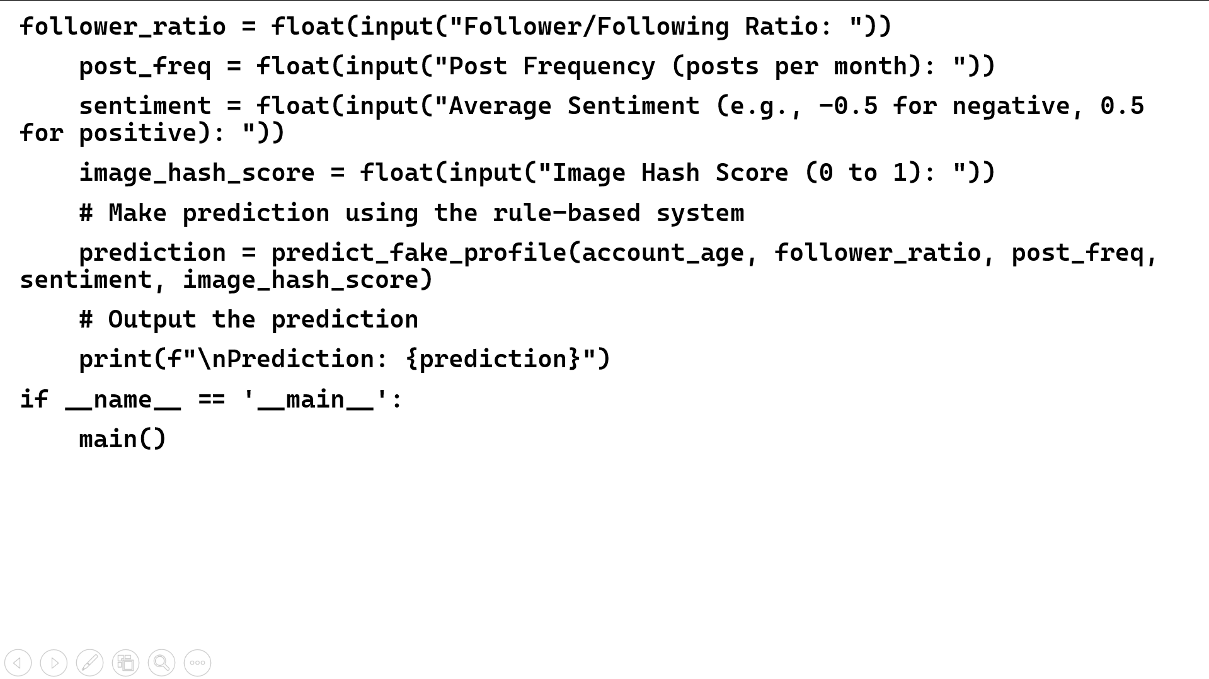

Slide 12
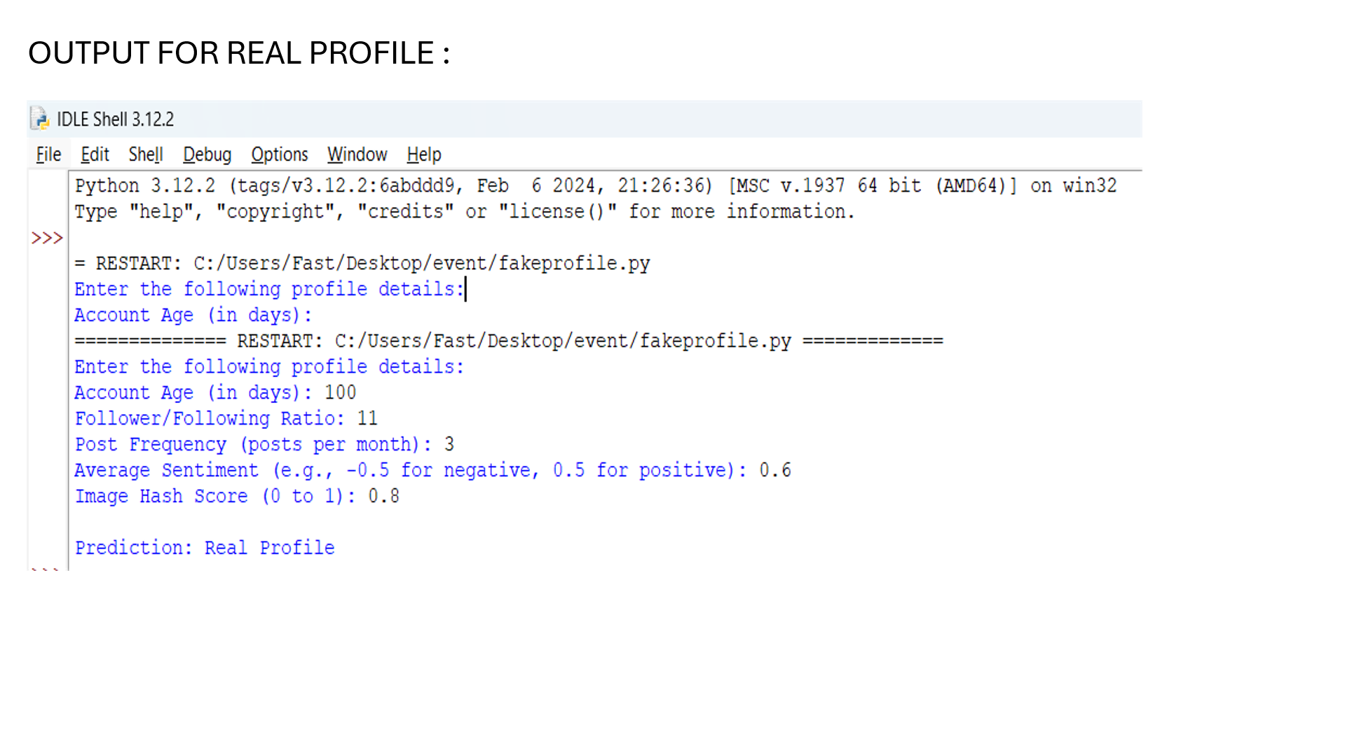

Slide 13
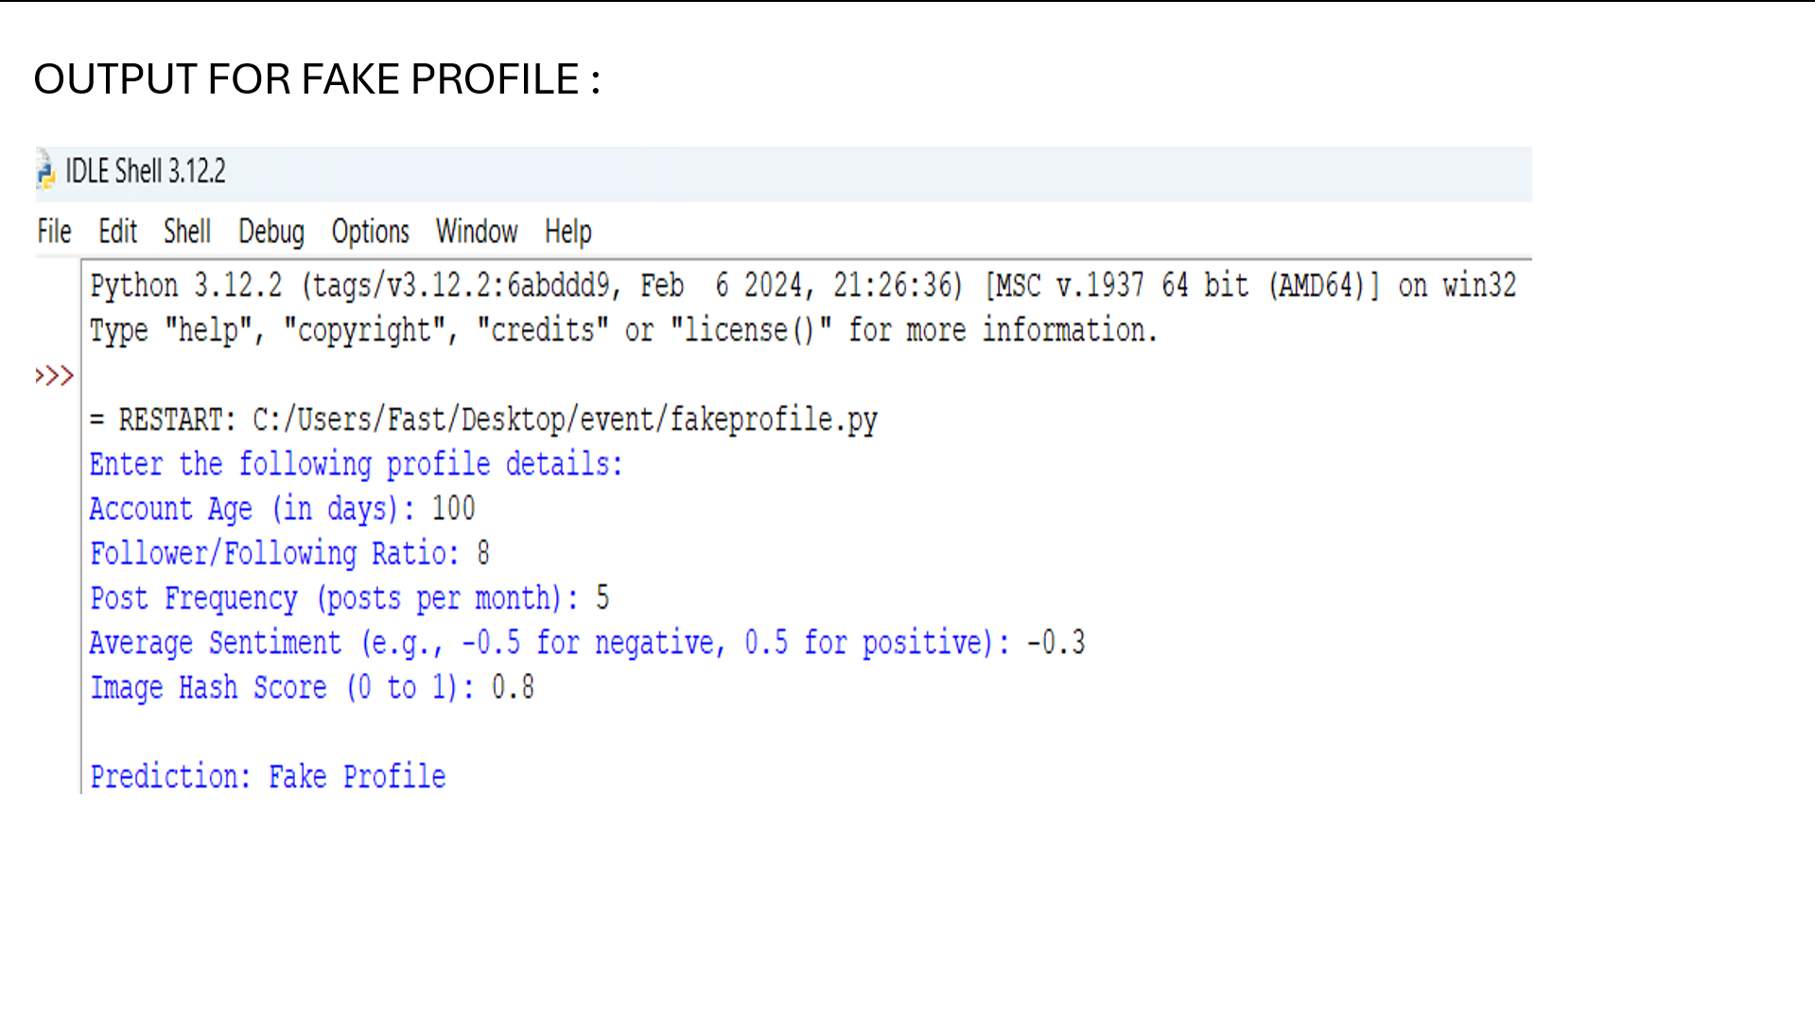

Slide 14
THANK YOU
“Your time is truly valued—thank you!”

